Slide 1

https://www.uni-goettingen.de/en/48115.html
Unless I explicitly state otherwise, images and cartoons are created using ChatGPT.
You may use this material free of charge under the terms of the CC BY license. This requires that you provide appropriate attribution to the author: W. Link, University of Goettingen, Germany.
In a few cases, individual images, photographs, or similar material may be subject to a more restrictive Creative Commons license. Where this applies, it is explicitly indicated, and you must comply with the stated license terms for those items.
Please check the license information carefully before reuse. Responsibility for complying with the applicable license terms rests entirely with you.
PopGen_Ch-10
Population Genetics; LD Linkage Disequilibrium II
1

Slide 2
Sequential Number: #11
UNPLAB-PopGen_Ch-10[LD II]
This symbol usually indicates that a page is rather important
2

Slide 3
You already know:
Hardy-Weinberg Equilibrium. Inbreeding Coefficient. Natural Selection, Fitness, Coefficient of Selection (aka Selection Coefficient). Balance between Selection and Mutation, joint effect of Selection and Drift. LD. Gamete Phase (Dis-)Equilibrium. Gamete Phases
Keywords of this chapter (Pop_Gen Ch-10):
LD. Impact of linkage, LD, gamete phases of parents of genetic variance from segregatation
Algebra:
Linkage. You find parameters λ and r (synonymous to c)
So-called linkage parameter λ. 0<λ<1, λ=0 means zero linkage, λ=1 means full linkage
So-called recombination value r (synonyme c). 0<c<0.5. 0.5 means 50:50 exchange (zero linkage), 0 means no exchange (full linkage); λ = 1-2c.
D between loci = r∙u-s∙t; r,s,t,u are frequency of two-loci haplotypes.
R² between loci = D² / [(p(A) ∙ q(a) ∙ p(B) ∙ q(b)]
3

Slide 4
How to quantify Gamete Phase Disequilibria? Here it is zero: We have Equilibrium
We take different allele frequencies in the 1. and 2. locus (p=0.5 vs p=1/6).
The table present a case of perfect Gamete Phase Equilibrium. Of course, the reason to take the super small sample of 12 gametes is just to deal with a short table, 12 is not a useful or typical number of gametes for Breeding, you know why.
One allele (here A or B) was coded as 1.
The ‚other‘ allele (here a or b) coded as 0,
to allow for Algebra.
Gametes at LD=0 cause, after Random Mating, a multi-locus HWE (aka Generalized HWE). See: We would then have 2p‘q‘ = 2(1/2)(1/2) heterozygotes (Aa) genotypes and 2p‘‘q‘‘=2(1/6)(5/6) heterozygotes (Bb); and ! (2p‘q‘)(2p‘‘q‘‘) = 4(1/4)(5/36) = (5/36) double heterozygotes AaBb (just as example).
4

Slide 5
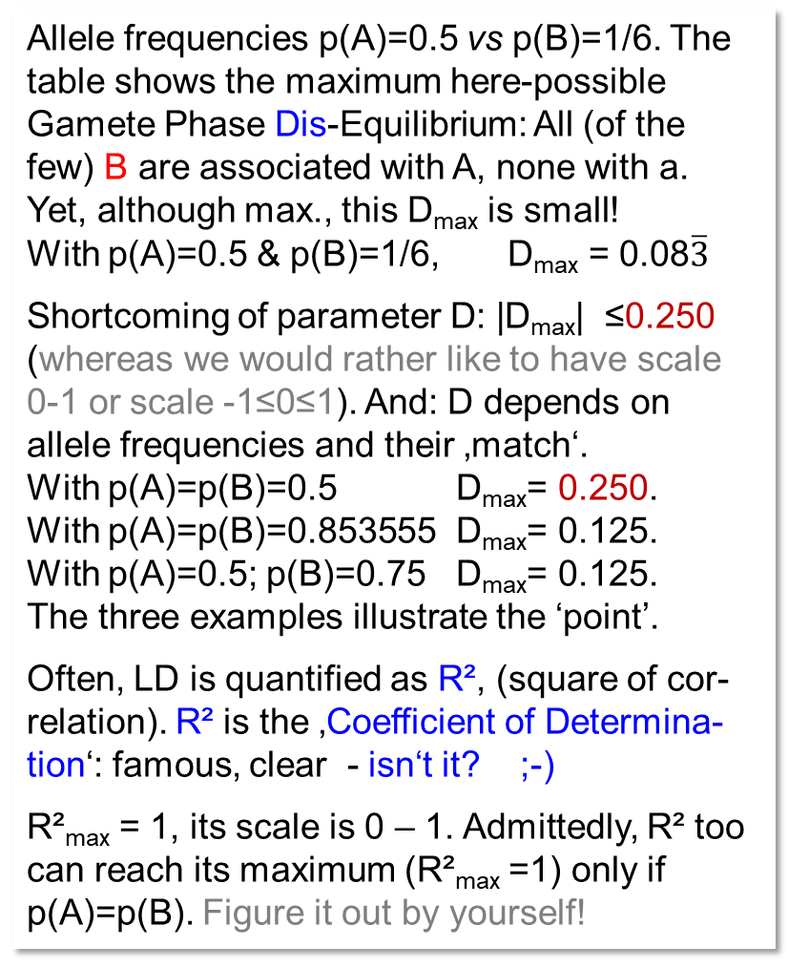
How to quantify a Gamete Phase Disequilibrium? E.g. as correlation between 2 loci.
Allele frequencies p(A)=0.5 vs p(B)=1/6. The table shows the maximum here-possible Gamete Phase Dis-Equilibrium: All (of the few) B are associated with A, none with a.
Yet, although max., this D_{max} is small!
With p(A)=0.5 & p(B)=1/6, D_{max} = 0.08$\overline{3}$
Shortcoming of parameter D: |D_{max}| ≤0.250 (whereas we would rather like to have scale 0-1 or scale -1≤0≤1). And: D depends on allele frequencies and their ‚match‘.
With p(A)=p(B)=0.5 D_{max}= 0.250.
With p(A)=p(B)=0.853555 D_{max}= 0.125.
With p(A)=0.5; p(B)=0.75 D_{max}= 0.125.
The three examples illustrate the ‘point’.
Often, LD is quantified as R², (square of cor-relation). R² is the ‚Coefficient of Determina-tion‘: famous, clear - isn‘t it? ;-)
R²_{max} = 1, its scale is 0 – 1. Admittedly, R² too can reach its maximum (R²_{max} =1) only if p(A)=p(B). Figure it out by yourself!
https://doi.org/10.3835/plantgenome2008.02.0089
5

Slide 6
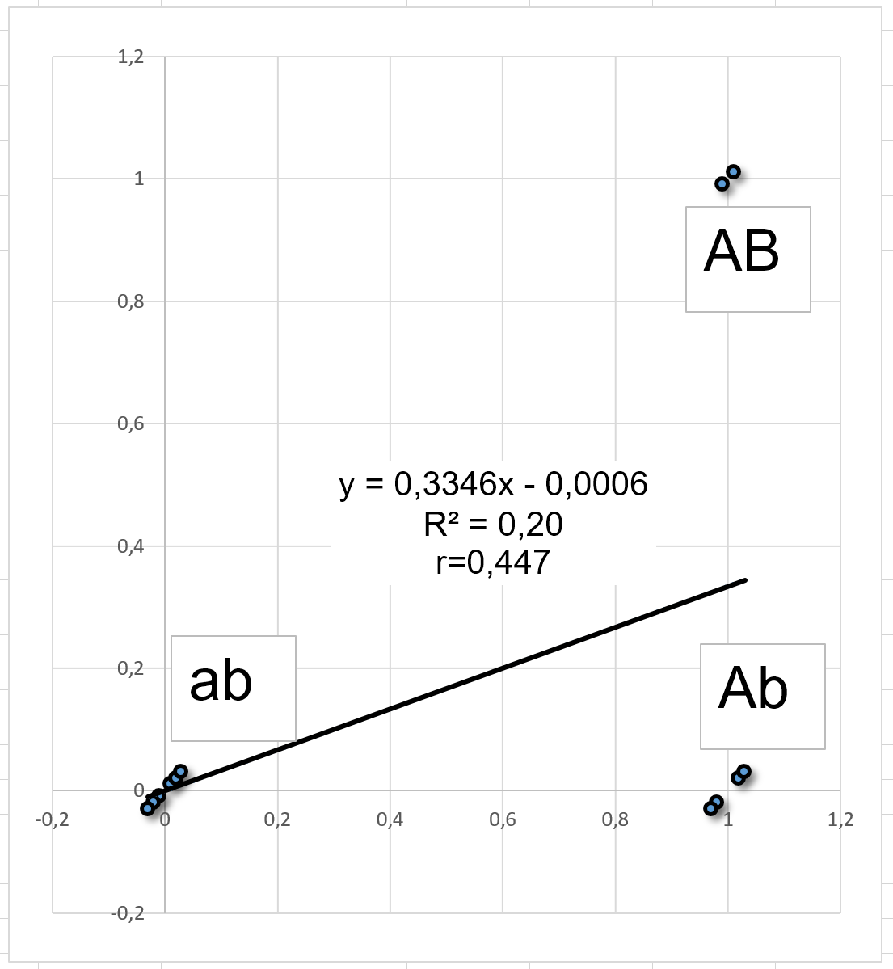
Although it shouldn't really be like this, perhaps someone doesn't really know what a correlation coefficient is. Hm ....
The higher the (positive or negative) correlation r, the nearer are the dots to the regression line. With r=1 or -1, the are on the line. The slope (here slightly less than b=1, means less than 45°) is the regression. The square of r is called R² - coefficient of determination.
Six are ‚ab‘, four are ‚AB‘, and two are ‚AB‘; zero are ‚aB‘. There is a slight association! All the few ‚B‘ are with ‚A‘, no ‚B‘ is with ‚a‘.
-2.5
-0.5
0.5
2.5
13
Mean
2.5
Y=0.3333∙x
R² = r² = 0.2000
r = 0.4472
12
R²=0.752
b =0.860
11
Interpret R² (0 < R² < 1) as the proportion of variance on Y-Axis that is ‘explained’ by the linear association of Y- and X-data.
Mean
Values on Y-asix (‘Dependent’)
10
9
8
-2.5
7
7
8
9
10
11
12
13
Dots are jittered
Values of X-axis (‘Independent’)

Slide 7
How to quantify Gamete Phase Disequilibria?
Still: Allele frequency is at the 1. locus p(A)=0.5; and
at the 2. locus p(B)=1/6.
The table now shows the 12 gametes that made D=0 plus
the 12 gametes that made D=1/12; yet, now joined as one population (array) of gametes.
Jointly, the 24 gametes result in D=1/24.
D is halved now (D=1/24 instead of D=1/12).
The correlation coefficient is halved now (r=0.22361instead of r=44721).
Yet, R² is not half but reduced to ¼, due to being a square value. R² = 0.05 instead of R²= 0.20.
Construct a negative LD! Just do it! Associate all of the few available ‚B‘ with ‚a‘ instead of ‚A‘. You will find: The abso-lute size of that Disequilibrium is the same.
The haplotype ‘aB’ has t=2/12 instead of t=1/12 as expected in Equilibrium.
Yet, sign is changed, D = -1/12 now. Minus!
Okay, D and r show such sign. R² is always positive.
7

Slide 8
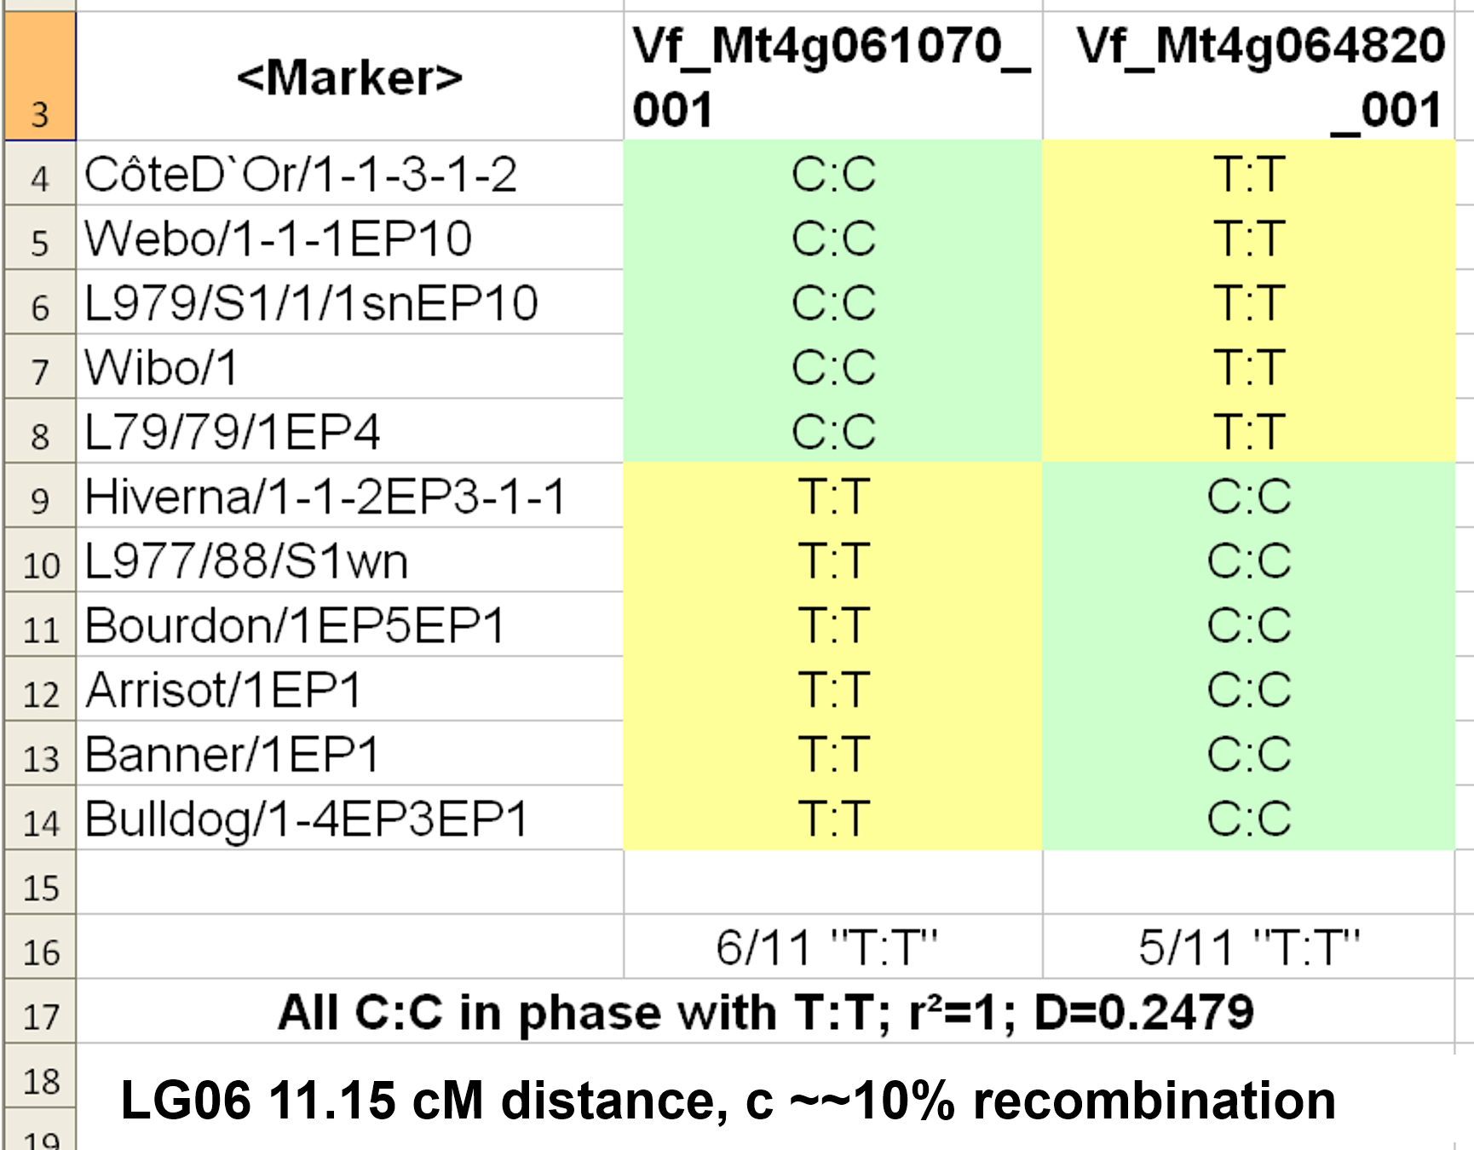
8
Some real data to illustrate LD (Ali et al., 2016)
Two SNP markers
Two so-called SNP markers. Two loci with (here) either ‘C’ or ‘T’ (C:C or T:T denote homozygosity).
The first five inbred lines are C:C at the first and T:T and second SNP locus. The further six lines are T:T and C:C (the first or se-cond SNP locus could as well have shown the alleles A or G; A/C/G/T are just the four bases).
1rst SNP: p(C) = 5/11 thus q(T) = 6/11
2nd SNP: p(T) = 5/11 thus q(T) = 6/11.
The haplotypes C:C-C:C and T:T-T:T do not occur here.
D = (5/11)∙(6/11) – (0/11)∙(0/11) = 30/11² = 0.247934
D is maximum yet D<0.25, since p≠q; p=q=0.5 is impossible with 11 lines ;-)
Inbred lines
1. locus
2. locus

Slide 9
Some real data to illustrate LD (Ali et al., 2016)
Two SNP markers
I manipulated the data here and gave alternative SNP alleles to the 2. marker locus; just to make clear: C:C and T:T are here what is ‚usually‘ AA and aa (or A₁A₁ and A₂A₂). And at the 2. locus, in reality it so happened that we had a polymorphism for the same two nucleotides (C versus T). But it could as well have been such as C versus G or, as I fake-chose, A versus G.
So, A:A and G:G stand for what ‚usually‘ would have been BB and bb (or B₁B₁ and B₂B₂).
LG means Linkage Group 6. In 2016, the assignments of markers to the physical chromosomes was unknown hence ‚linkage groups‘ were listed instead. The two loci were linkage-mapped with 11.15cM dis-tance, this is very roughly a 10% probability of recombination per meiosis.
DOI: 10.1093/genetics/125.4.669.
11 inbred lines
Inbred lines
1. locus
2. locus
A:A
A:A
A:A
A:A
A:A
G:G
G:G
G:G
G:G
G:G
G:G
A:A
9

Slide 10
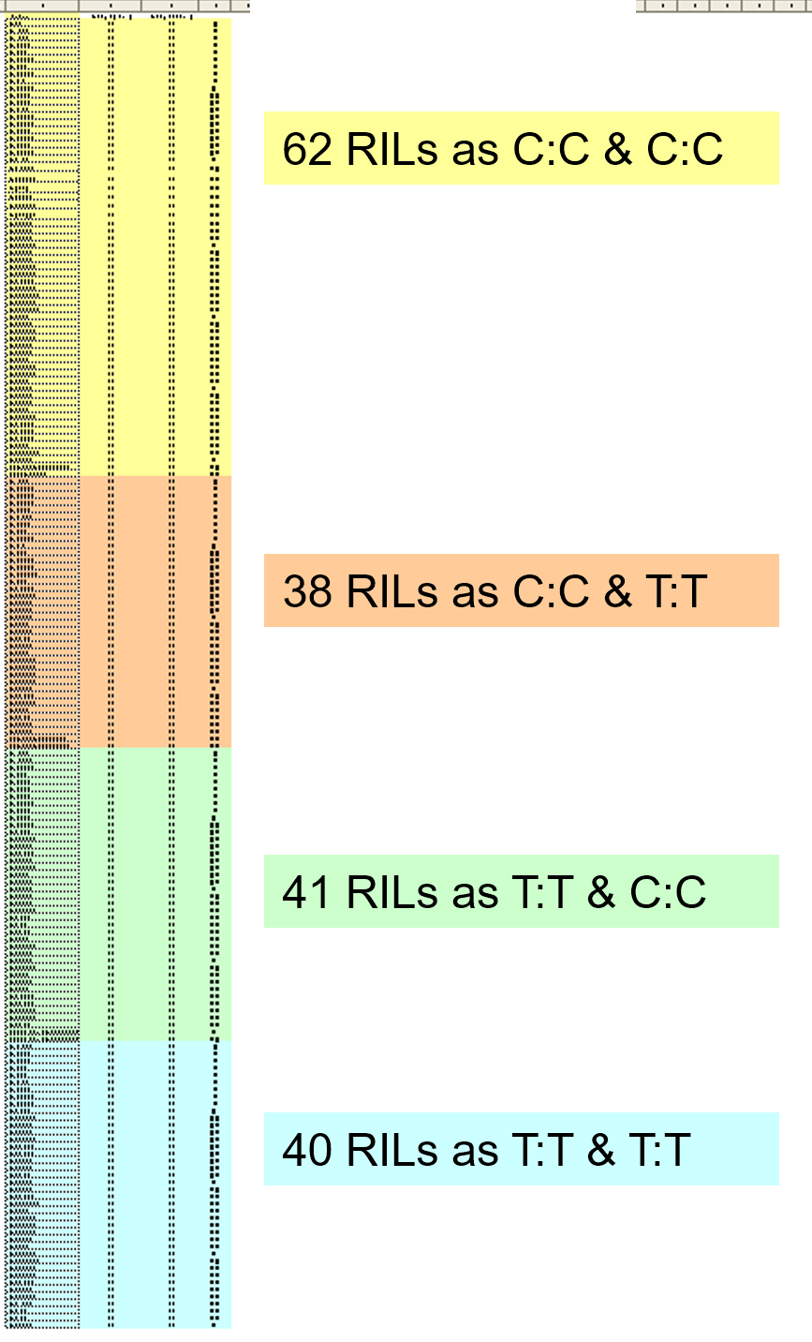
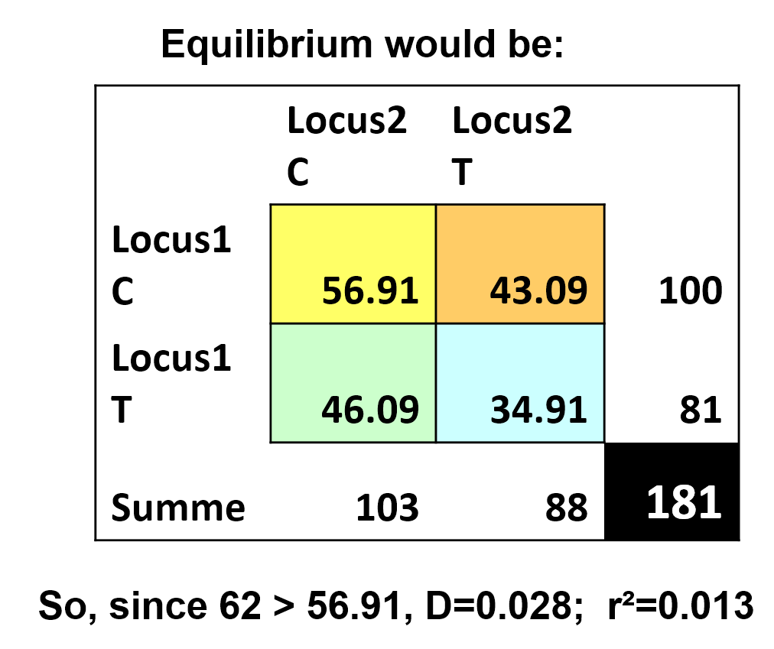
181 lines (bred via single-seed-descent) from a recombining population - which in turn originated from mixing the 11 inbred lines that we have just seen. LD of the 181 lines decayed very much compared to the LD of the 11 lines
In this set of recombined inbred lines (RILs; N=181), we find at the first SNP-locus p(C)=100/181, a slight increase compared to p(C)=5/11. “No Selection no Mutation no Drift no Migration” was not perfectly realized for this locus.
At the second SNP locus, p(C)=103/181, nearly the same as before (6/11). Quite okay.
If we had LD=0, then for instance homozy-gous lines ‘C:C-C:C’ should occur with r=(100∙103)/181² ≙ 0.3144%, which is, with N=181, about 57 of the 181 lines. In reality, 62 of the lines showed this results. LD is nearly zero now. D=0.028; R²=r²=0.013.
78
Each in-bred line here stands for one gamete-type. 62 lines C:C & C:C tell us that the array of gametes that could be - randomly - taken from this random set of inbred lines is expected to have 62/181 = 34.25% of gametes of type C-C.
10

Slide 11
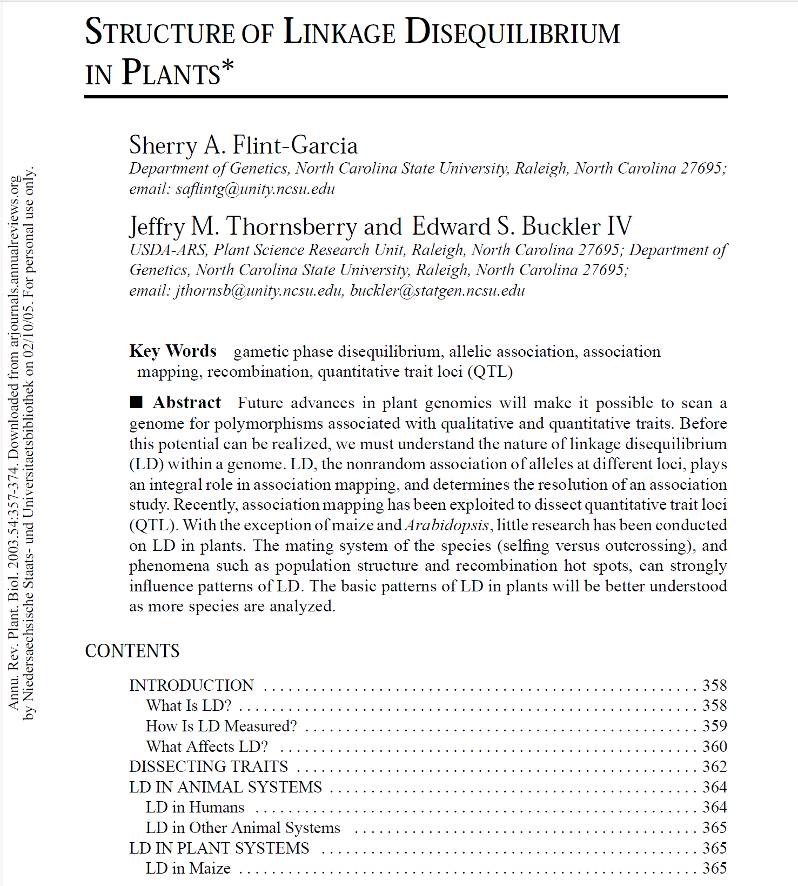
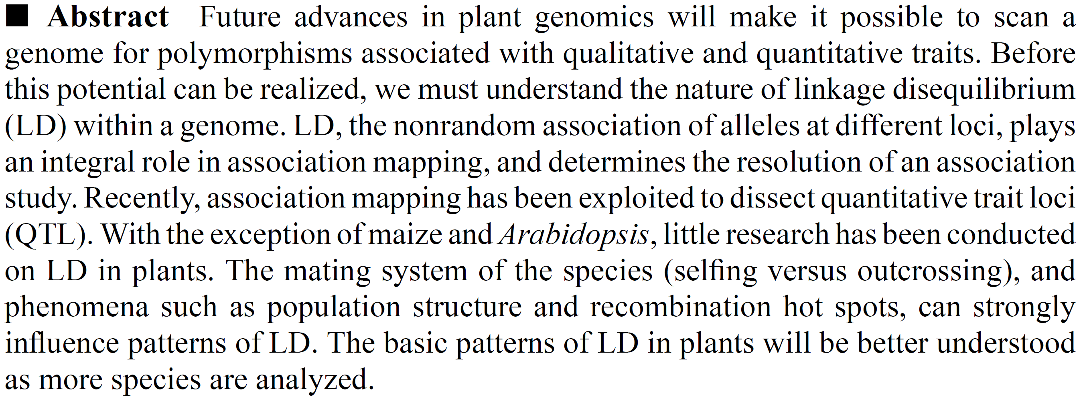

Here I advertise the topic of LD by showing how indeed prominent scientists* devote their time to explain it to us.
Future of 2003 is … ‚today‘!
*Buckler jr, aka Buckler IV. A famous, imaginative scientist from Cornell with a significant international fan base.
Orcid 0000-0002-3100-371X
11

Slide 12
Gamete Phase Disequilibrium (LS) is of high relevance for many topics and areas in Plant Breeding (and Applied Genetics in general). I try to emphasize LD by focussing on just one of them. Given that loci are more or less linked if they are located in chromosomal vicinity (this is generally true), then …
… their LD causes correlations between ‘their’ traits, and these correlations decay as LD decays: Expected decay depends on strength of linkage.
... LD causes correlations between useful DNA-markers and ‘their’ QTL. These cor-relations decay as LD decays, expected decay depends on strength of linkage.
... LD and actual type of gamete phase in cross parents has impact on the size of the genetic variance due to segregation from such cross; thus LD impacts ‚Usefulness‘ of crosses, depending among other factors on fortunate or unfortunate gamete phases in the parents.
DOI 10.1098/rstb.2007.2170
DOI 10.1007/s001220051106
12

Slide 13
Impact of LD on genetic variance. In Breeding; in Population Genetics.
Six loci. Genetically linked with direct neighbour with λ = 0.95 (tight linkage, recombination ~5%). Linkage with next-nearest neighbour is then λ = 0.95²; et cetera; well, simple model.
Each locus contributes an impact-to-trait of +1 in case of AA or of zero in case of aa (or in case of BB ...). We consider the DH offspring of a six-fold heterozygous individual (genotype).
Well, heterozygous in a very specific way: It received from mother ‘ABCDEF’ and from father ‘abcdef’ – maternal chromosome (maternal haplotype) drawn here. Du to linkage, most of the gametes (most DH offspring) that come from such heterozygous individual will be the un-recom-bined haplotype ABCDEF or abcdef (AA/BB/CC/DD/EE/FF or aa/bb/cc/dd/ee/ff).
The joint probability of these two majority-types of gametes (multiple coupling phase haplotype) will be: P≈0.95⁵ = 0.7738. Both will occur with 38.69% instead of with 50.00% (since λ ≠ 1.0).
What is the probability of this types of gametes: ABCDEf, hence, with one recombination? It is P≈(0.95⁴ ∙ 0.05)/2 = 0.0204. There are 10 (since (5²-5)/2 = 10) types of gametes with just one recombination. Altogether, we expect 20.36% of gametes with one recombination. They harbour
one (abcdeF) or two (abcdEF) ... up to five ‘positive’ alleles (therefore trait values 1 to 5).
We expect 2.1434% of gametes (or DH lines) with two recombination; and 0.1128% with three recombinations; and 3 in 100.000 with four and 3 in 10 millions with five (two types: AbCdEf and aBcDeF).
A
B
C
D
E
F
DH offspring of a six-fold heterozygous individual (genotype).
Recombination and Segregation steers genetic variance. Evolution and breeders‘ success depend on genetic variance. Let us ponder the impact of linkage and allele phases (haplotypes) on genetic variance.
DOI: 10.1007/s00122-019-03433-x
13

Slide 14
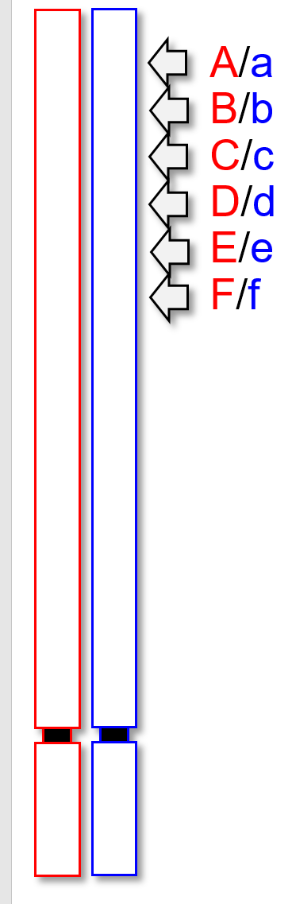
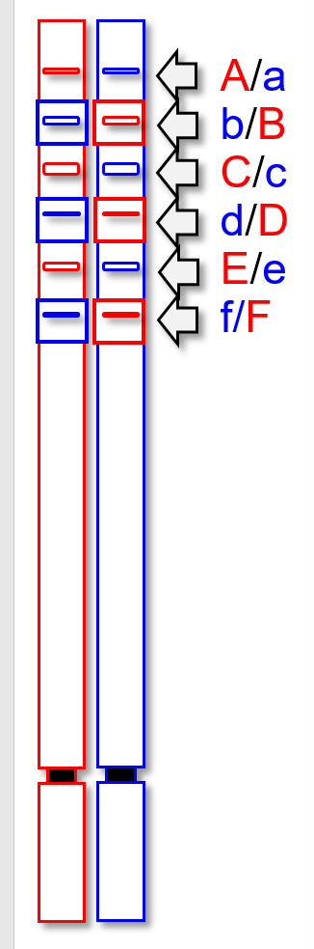
Impact of LD between ... loci on genetic variance due to segregation
100
How is it possible that the ‘same’ F1
Aa/Bb/Cc/Dd/Ee/Ff can produce offspring (DH Populations, i.e., sets of homozygous inbred lines) that segregate so differently (you see the four cases)?
50
DH Population with D=0.25
DH Population with D=0.00
40
DH Population with D=0.2375
DH Population with D=-0.25
30
Frequency (%)
20
10
0
0
1
2
3
4
5
6
Trait value from 0 up to 6
14

Slide 15
Impact of LD on genetic variance. In Breeding; in Population Genetics.
Six loci. Genetically linked with direct neighbour with λ = 0.95 (tight linkage, recombination ~5%). Linkage with next-nearest neighbour is then λ = 0.95²; et cetera; well, simple model.
Each locus contributes an impact-to-trait of +1 in case of AA or of zero in case of aa (or in case of BB ...). We consider the DH offspring of a six-fold heterozygous individual (genotype).
Well, heterozygous in a very specific way: It received from mother ‘ABCDEF’ and from father ‘abcdef’ – maternal chromosome (maternal haplotype) drawn here. Du to linkage, most of the gametes (most DH offspring) that come from such heterozygous individual will be the un-recom-bined haplotype ABCDEF or abcdef (AA/BB/CC/DD/EE/FF or aa/bb/cc/dd/ee/ff).
The joint probability of these two majority-types of gametes (multiple coupling phase haplotype) will be: P≈0.95⁵ = 0.7738. Both will occur with 38.69% instead of with 50.00% (since λ ≠ 1.0).
What is the probability of this types of gametes: ABCDEf, hence, with one recombination? It is P≈(0.95⁴ ∙ 0.05)/2 = 0.0204. There are 10 (since (5²-5)/2 = 10) types of gametes with just one recombination. Altogether, we expect 20.36% of gametes with one recombination. They harbour
one (abcdeF) or two (abcdEF) ... up to five ‘positive’ alleles (therefore trait values 1 to 5).
We expect 2.1434% of gametes (or DH lines) with two recombination; and 0.1128% with three recombinations; and 3 in 100.000 with four and 3 in 10 millions with five (two types: AbCdEf and aBcDeF).
A
B
C
D
E
F
Recombination and Segregation steers genetic variance. Evolution and breeders‘ success depend on genetic variance. Let us ponder the impact of linkage and allele phases (haplotypes) on genetic variance.
DOI: 10.1007/s00122-019-03433-x
15

Slide 16
Impact of LD on genetic variance. In Breeding; in Population Genetics
A/a
B/b
C/c
D/d
E/e
F/f
The two parental lines which make our sixfold heterozygous genotype
Parent 1 = AA/BB/CC/DD/EE/FF; trait value 6
Parent 2 = aa / bb /cc / dd /ee / ff; trait value 0 ...
are mentioned in the table with genetic variance σ²_{G}=9.000. It is not a very meaningful case by itself, yet, it serves as comparison with further cases.
Gametes taken (for DH) from the hybrid Aa/Bb/Cc/Dd/Ee/Ff came from the meiosis in this hybrid.
Via the DH-technique, plant breeders would convert gametes from this F1 into corresponding homozygous inbred lines. The full pool (no Se-lection etc.) of gametes taken from our 6-fold heterozygous F1 is considered here; honestly: The full pool of DH-lines made from them.
DH-technique: DOI 10.1038/nbt0688-684
16

Slide 17
Impact of LD on genetic variance. In Breeding; in Population Genetics
The haplotype ‘ABCDEF’ constitutes the mother, the ‘complementing’ haplotype (‘abcdef’) consti-tutes the father of our cross. Together they realize maximum Coupling Phase Disequilibrium with D=0.25 (R²=1).
We study the ‘undisturbed’ (no Selection etc.) gametes taken from our F1 Aa/Bb/Cc/Dd/Ee/Ff which is realised by studying the DH-lines made from it. Their LD is reduced from D=0.25 by meiosis (meiosis in ‘making’ the gametes that come from this F1). Yet: For directly neigh-boured loci, reduction is by only 5% - because of the strong linkage (λ=0.95).
The pool of DH-lines thus contains few inter-mediate types with trait values 1-5 (such types resulted from one cross-over after the first or before the last locus; or from multiple recombinations in this stretch of 6 loci). LD can not be reduced further because of the full homozygosity of the DH-lines – LD is high and is fixed until DH are crossed with each other.
A/a
B/b
C/c
D/d
E/e
F/f
17

Slide 18
Impact of LD on genetic variance. In Breeding; in Population Genetics
What if … we did not produce these homozygous (DH) lines with only one meiosis but via the so-called SSD-process (going from F1 to F2 to F3 ... F∞ etc.? ... Making so-called RILs (recombinant inbred lines; no Selection Mutation Migration Drift)? Would then LD be reduced further to a low value of D∞?
Repeated self-fertilization (as in SSD) creates homozygosity relatively fast, and LD between two loci can only be further reduced if both loci are ‚still‘ heterozygous. Thus, the further decay of LD (after what the F1 did via its meiosis for its gametes) is little.
The table has it. The RILs have a little-further reduced LD = D∞, the two extreme types are still dominating, the trait variance was not much reduced (from 7.415 to 6.234).
A/a
B/b
C/c
D/d
E/e
F/f
SSD, single-seed-descent.
DOI 10.1007/BF00273777
18

Slide 19
Impact of LD on genetic variance. In Breeding; in Population Genetics
A/a
B/b
C/c
D/d
E/e
F/f
We may analyse a different setting: Our initial F1 produces offspring which further propagates by random mating (no Selection etc.). With this, LD will decay across further generations, slowly because of λ=0.95, but: After 90 generations, less than 1% of the initial LD will be present. What, with D≈0, will be the frequency of ga-metes that would give DHs with extreme (0, 6) and intermediate (1-5) trait values?
The tables shows: With D=0, there are only about 3.125% extreme genotypes (value 6 or 0) are left (0.5⁶=0.015625); the vast majority of genotypes has trait values of 2, 3, 4.
With six loci, we are already approximating a normal distribution of values. Accordingly, the genetic trait variance was much shrinked, down to σ²_{G}=1.500.
19

Slide 20
Impact of LD on genetic variance. In Breeding; in Population Genetics
What if we did not start with crossing
Parent 1 = AA/BB/CC/DD/EE/FF with
Parent 2 = aa/bb/cc/dd/ee/ff)
but with crossing
Parent 1 = AA/bb/CC/dd/EE/ff with
Parent 2 = aa/BB/cc/DD/ee/FF) !?
Now, initially LD between directly neighboured loci is D=-0.25. The two parents share the same genetic trait value: G=3 (3 ‚+‘ alleles and 3 ‚-‘ alleles per parent). With zero trait difference between P1 and P2, we have zero variance between the parents (last column of table).
Cross P1 x P2, parents have now same value. Let their offspring recombine many generations. By and by, negative LD will vanish and LD=0 will be approached, hence σ²_{G} > 0. We can identify inbred offspring with values as extreme as 0 and 6 (see column with D=0 in table). Magic? You cross parents that perform same yet they segre-gate clearly different offspring.
A/a
b/B
C/c
d/D
E/e
f/F
20

Slide 21
21
21
Impact of linkage-protected LD between loci on genetic variance between offspring
Parent 1 = AA/BB/CC/DD/EE/FF
Parent 2 = aa/bb/cc/dd/ee/ff
Offspring generations of this cross see a decay in LD. With only one meiosis from F1, gametes show D=0.2375 and random DH-lines thereof still mainly realize the extreme coupling types (grey columns). With very many meiose along random mating gene-rations, LD decays to zero: Equilibrium arrays of gametes evolves. DH-lines from them would realize the green columns with extreme inbred lines being rare.
Parent 1 = AA/bb/CC/dd/EE/ff
Parent 2 = aa/BB/cc/DD/ee/FF
Both parents share same trait value. In their recom-bined inbred offspring, we see as surprise the unfol-ding of variance from segregation and a decay of D=-0.25 towards zero. Still, we focus on the DH-lines made from the gametes of each generation. Although then the extreme DH types occur, they are rare (green columns). If the trait was polygenic with many more loci (N>>1), at LD=0 the extreme types would not appear (very small probability P = 0.5^{N}).
100
50
DH Population with D=0.25
DH Population with D=0.00
40
DH Population with D=0.2375
DH Population with D=-0.25
30
Frequency (%)
20
10
0
0
1
2
3
4
5
6
Trait value from 0 up to 6
The case of marked LD and unfolding of novel, so far unseen diversity is expected if crossing elite x elite. Marked LD and decay of diversity is expected if crossing is elite x exotic.

Slide 22

So far ... nearly the End of our Chapters on Population Genetics (cf: ISBN: 9781605351537) – only one chapter more to come ... [LD III]
Remember (this is no exhaustive list):
Genotype frequencies P;H;Q. Allele frequencies p;q. HWE shows path from p and q to P and H and Q. Know preconditions for HWE. Inbreeding, Selfing, degree of Homozygosity vs. Inbreeding coefficient F, Heterozygosity vs. Panmictic index P. Alike in State (ais) vs. Identical by Descent (id). Random Genetic Drift, impact on variance and on inbreeding coefficient F, Natural Selection, Fitness, Selection Co-efficient s. Change of allele frequency per generation of selection, impact of s, of reproductive mode and of gene action. Joint occurrence of Selection and Mutation, joint occurrence of Selection and Drift. Gamete Phase and (Dis)Equilibrium (aka Linkage (Dis)Equilibrium LD). Impact of linkage parameter λ, LD and paternal ga-mete phase on size of genetic variance from segregation between offspring.
https://s.gwdg.de/
oYOysq
https://www.researchgate.net/publication/267845714_Lecture_Notes_in_Population_Genetics
22

Slide 23
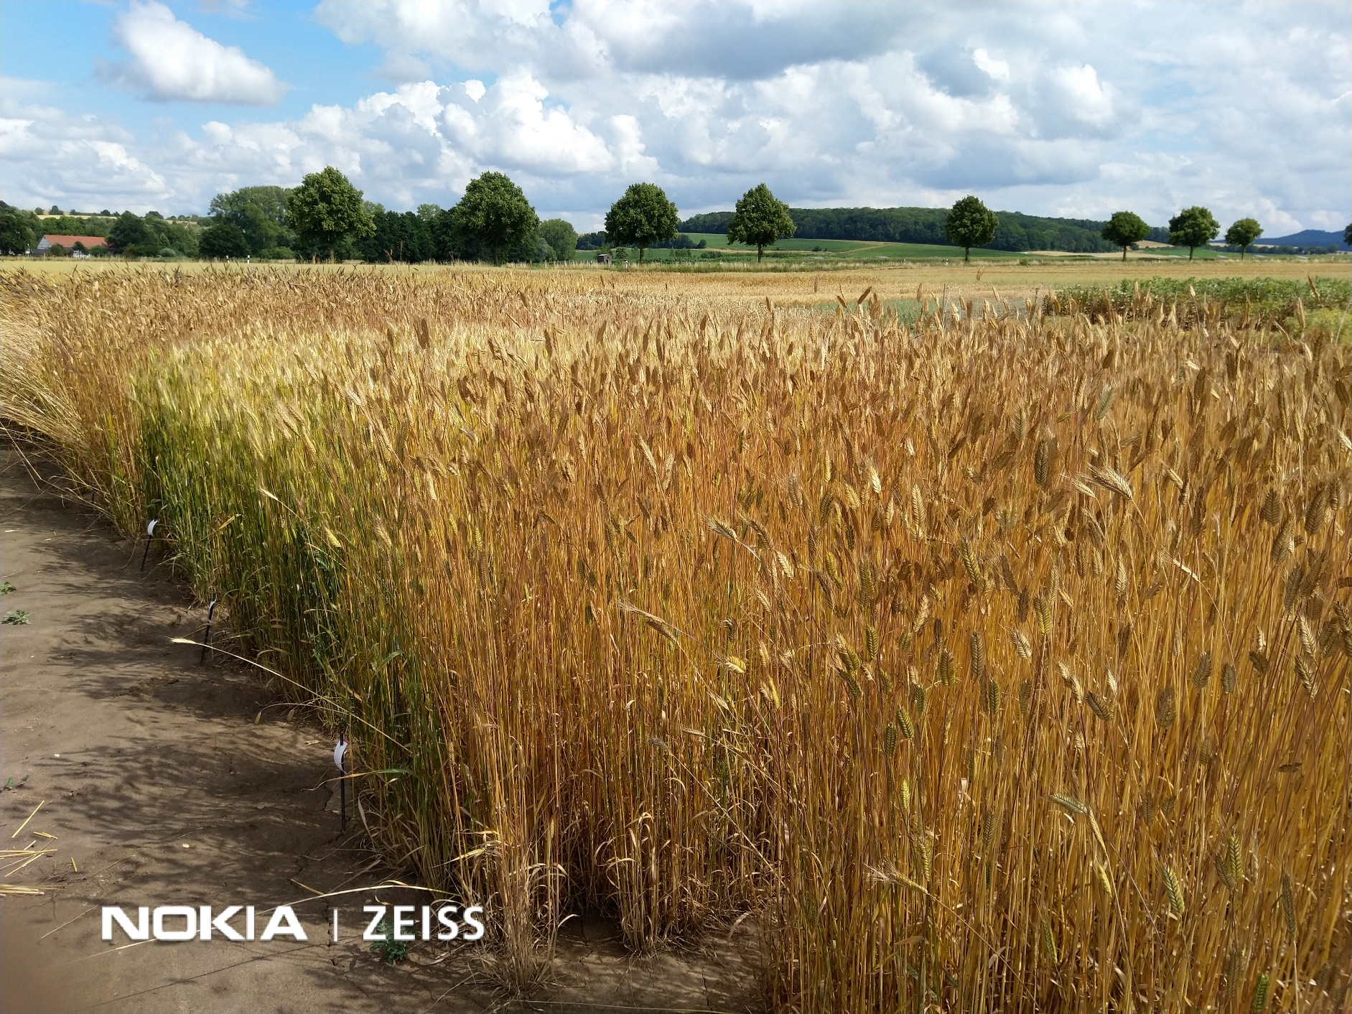
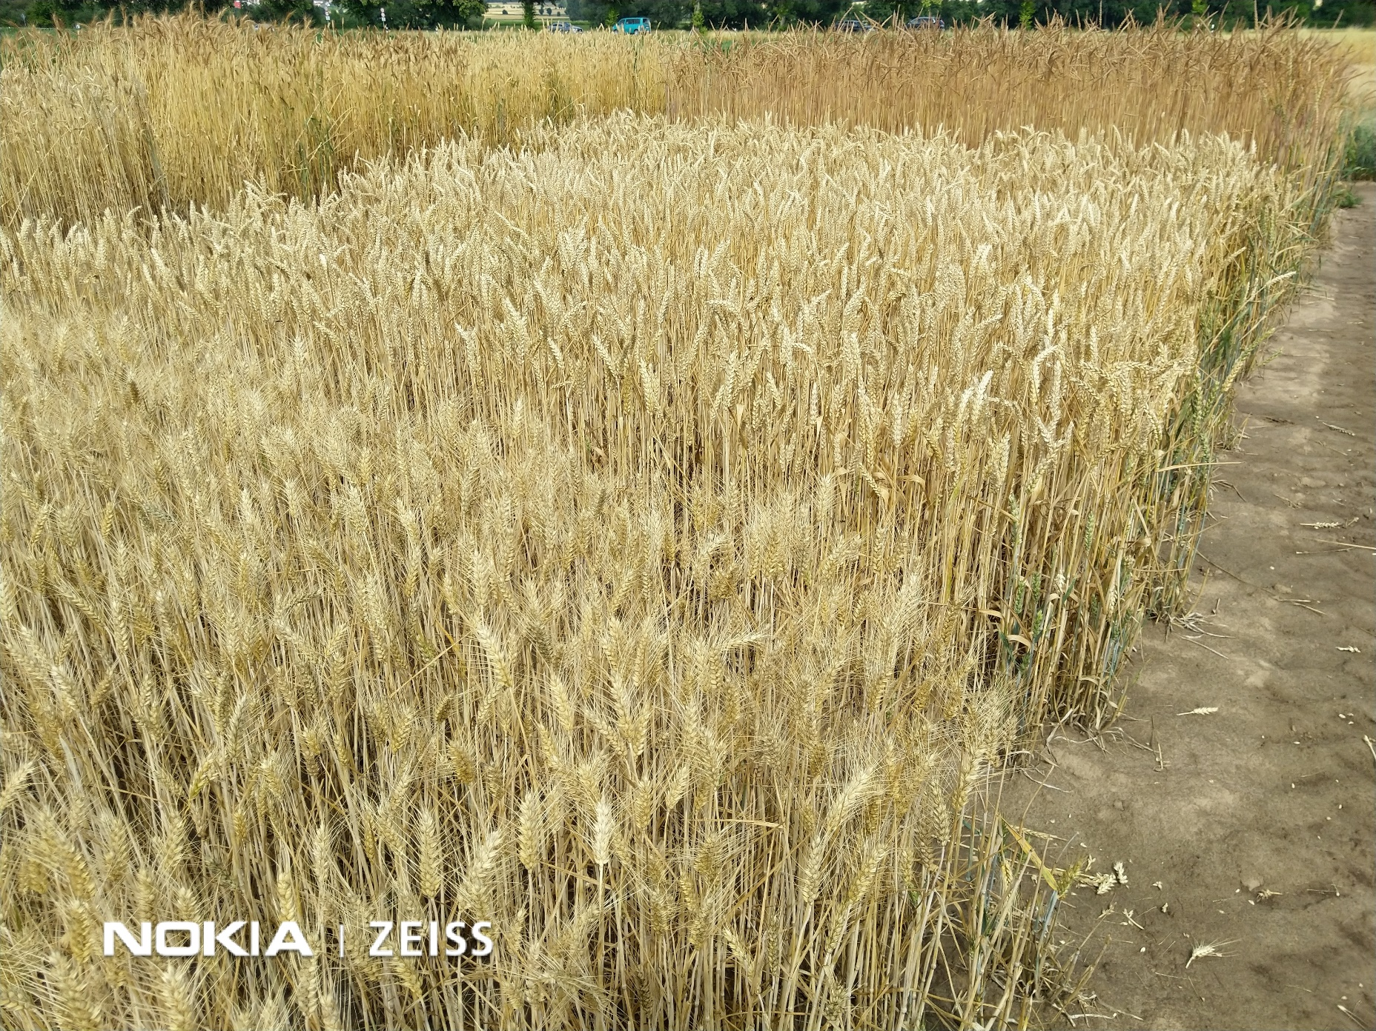
From here your may move on to Pop_Gen Ch-11[LD III], a chapter on the use of LD as the essence of MAS (marker-assisted selection), so that Population Genetics here already gives a very strong foresight into Plant Breeding and Selection
© WL; Reinshof ‘25
23
23

